Slide 1
Ethernet

Slide 2
Ethernet (1 of 2)
Ethernet is the most important data link layer standard
It is capable of running on a variety of network media
Ethernet offers excellent throughput at a reasonable cost
It is the most popular network technology used on modern LANs
Ethernet II is the current standard
Ethernet adds both a header and a trailer to the payload
This creates a frame around the payload
The header and FCS make up the 18-byte “frame” around the data
The data portion of an Ethernet frame may contain from 46 to 1500 bytes
MTU (maximum transmission unit) is the largest size that routers in a message’s path will allow at the Network Layer

Slide 3
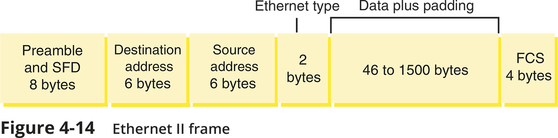
Ethernet (2 of 2)

Slide 4
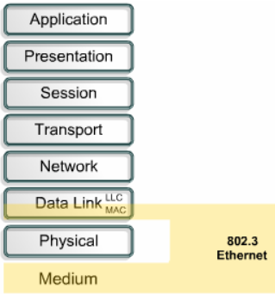
Ethernet and the OSI Model
Ethernet operates in two areas of the OSI model:
the lower half of the data link layer, known as the MAC sub layer
and the physical layer

Slide 5
Data link layer – Two Sub-layers
Logical link Control (LLC) : (IEEE 802.2)
The Logical Link Control (LLC) sublayer remains relatively independent of the physical equipment
Provides an interface between the MAC layer and the Network layer independent of the hardware
Media Access Control (MAC): (part of IEEE 802.3)
The MAC sub-layer is concerned with the physical components that will be used to communicate the information
Which computer can access the network when multiple computers are trying to access it simultaneously
Physical addressing (MAC addresses) and access control methods.

Slide 6
Ethernet Frames
Field name |  | Length | Description
Preamble and SFD |  | 8 bytes | Signals to the receiving node that bytes following this preamble are the actual frame. Not included when calculating a frame’s total size.
Header | Destination address | 6 bytes | Provides the MAC address of the recipient of the data frame.
 | Source address | 6 bytes | Provides the MAC address of the network node that originally sent the data.
 | Type field | 2 bytes | Specifies the upper-layer protocol carried in the frame. E.g. an IP packet has 0x0800 in the Type field.
Data |  | 46 to 1500 bytes | If the data is not at least 46 bytes, padding is added to make a minimum of 46 bytes.
Trailer FCS (frame check sequence) |  | 4 bytes | The FCS trailer ensures that the data at the destination exactly matches the data issued from the source using the CRC (cyclic redundancy check) algorithm.

Slide 7
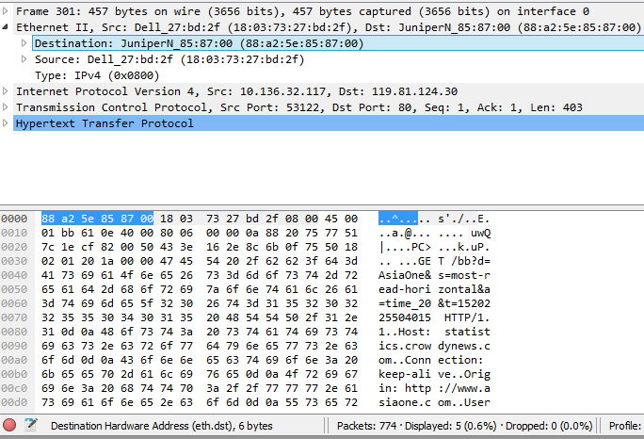
Ethernet Frames
Preamble and SFD
Header
Data
Trailer
8 bytes
6 bytes
6 bytes
2 bytes
46-1500 bytes
4 bytes

Slide 8
Types of Ethernet
10-Mbps Ethernet
100 Mbps Fast Ethernet
Gigabit Ethernet
10 Gigabit Ethernet
10BASE5, 10BASE2, and 10BASE-T Ethernet are now considered Legacy Ethernet

Slide 9
IEEE Ethernet Standards
IEEE 802 Committee Standards:
802.1 - Standards introduction
802.2 - Logical Link Control (LLC)
802.3 - Ethernet
802.4 - Token Bus - 75 ohm CATV coax or Fibre
802.5 - Token Ring
802.6 - MAN (Metropolitan Area Network) - similar to FDDI
802.7 - Broadband
802.8 - Fibre Optics
802.9 - Integrated Voice and Data
802.10 - LAN Security
802.11 - Wireless
802.12 - 100 VG AnyLAN
802.15 - Bluetooth
802.16 - WiMax

Slide 10
Ethernet
Ethernet performs three functions:
Transmitting and receiving data frames
Uses CSMA/CD (non-deterministic)
Carrier Sense Multiple Access / Collision Detection
Decoding data frames and checking them for valid MAC addresses
before passing them to the upper layers of the OSI model
Detecting errors within data frames or on the network
Note that Ethernet performs error detection but NOT error correction
Any frame with an incorrect checksum is an error
Also, any frame under 64 bytes in length is an error

Slide 11
Ethernet
Ethernet was originally designed to work on networks with a shared medium
physical bus topology
star topology created with a hub
If multiple nodes attempt to communicate at the same time, the signals will interfere
called a collision
CSMA/CD is used for controlling access to the shared medium

Slide 12

CSMA/CD

